Slide 1

VII –th week!
Kovács Gábor /Kovi/

Slide 2
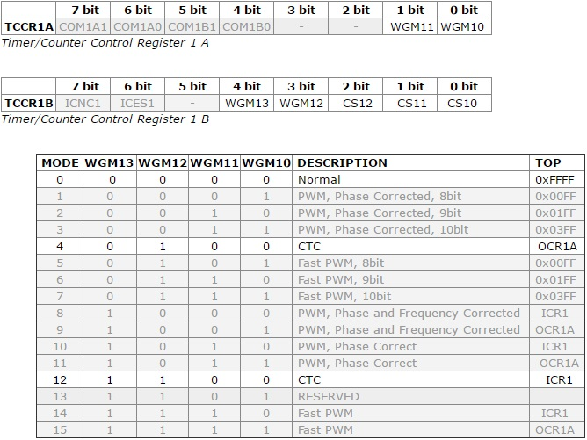
Information from datasheet!

Slide 3
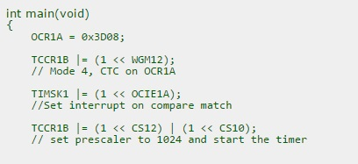
Information from datasheet!

Slide 4
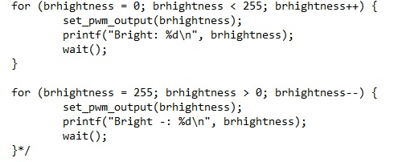
77
PWM!
Light intensification.

Slide 5

PWM!
Light intensification solution

Slide 6
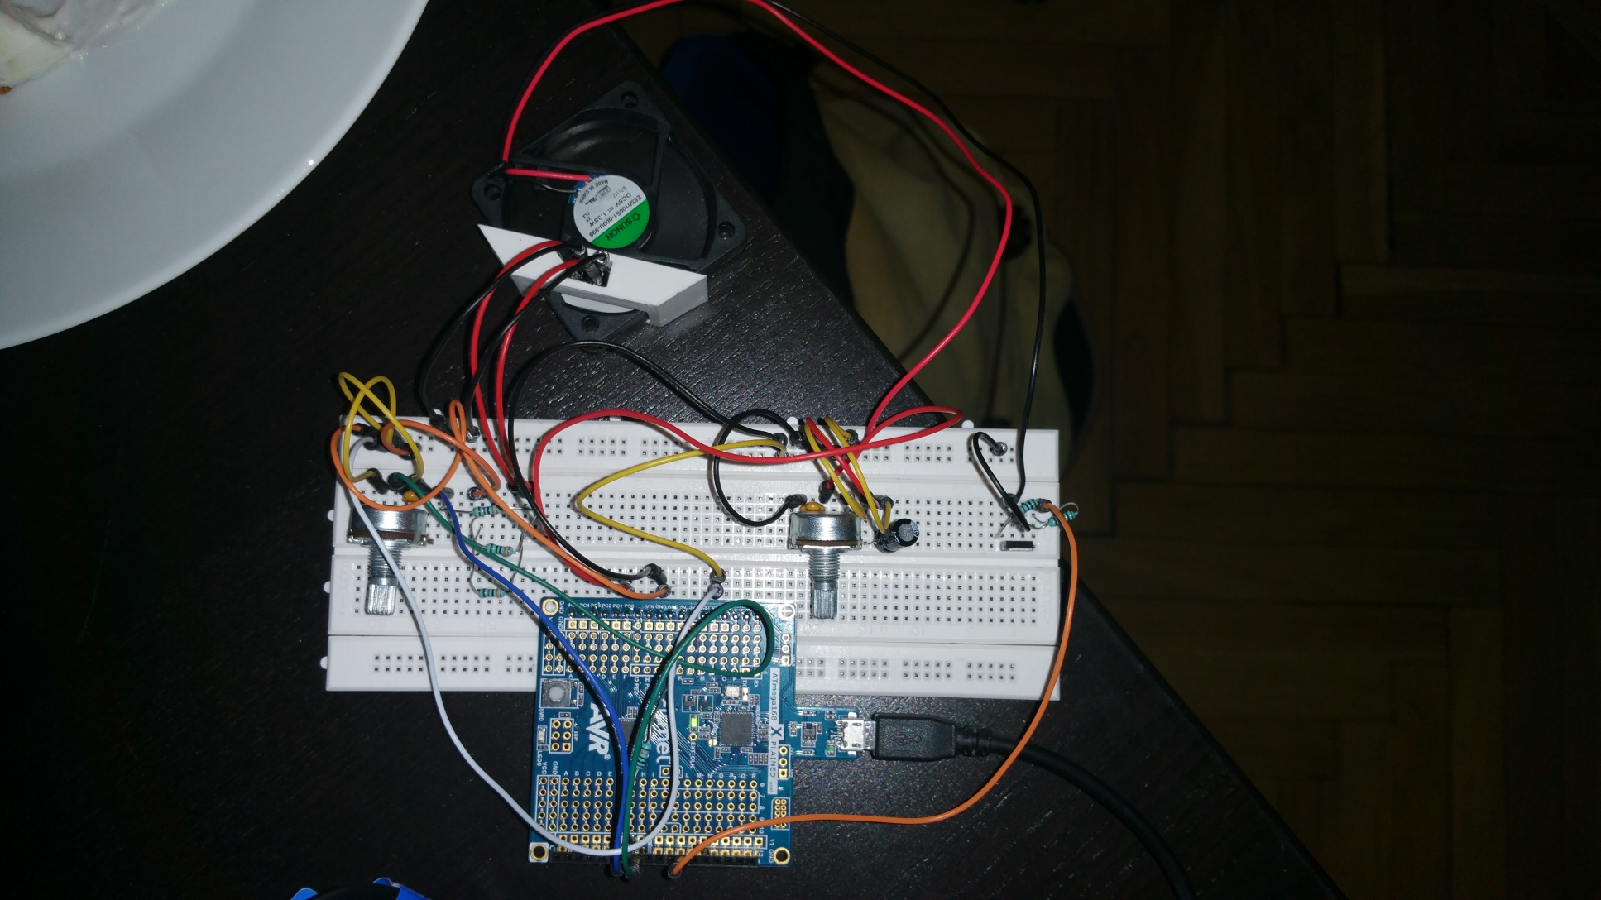
Forever play!

Slide 7

Köszönöm a figyelmet!

